Slide 1
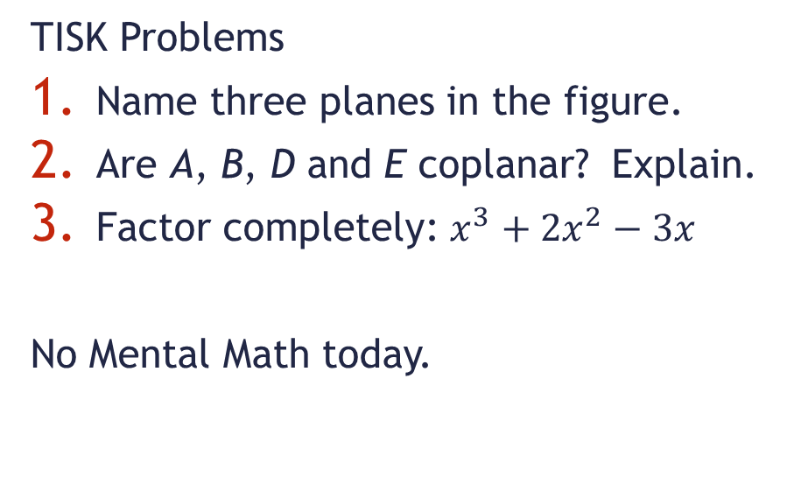
Monday, August 27, 2012
F
TISK Problems
Name three planes in the figure.
Are A, B, D and E coplanar? Explain.
Factor completely: $x^{3}+2x^{2}−3x$
No Mental Math today.
J
E
A
G
H
D
B
C
HOMEWORK:
p. 96 Complete #13-23 mentally, complete #24-27 in writing

Slide 2
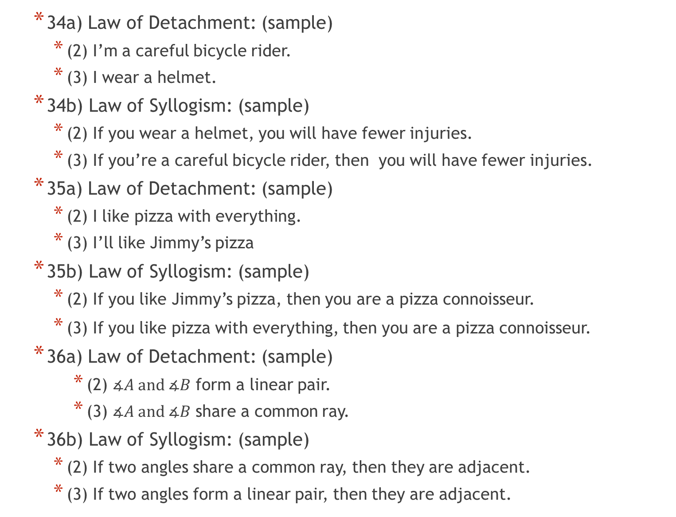
Homework Check
34a) Law of Detachment: (sample)
(2) I’m a careful bicycle rider.
(3) I wear a helmet.
34b) Law of Syllogism: (sample)
(2) If you wear a helmet, you will have fewer injuries.
(3) If you’re a careful bicycle rider, then you will have fewer injuries.
35a) Law of Detachment: (sample)
(2) I like pizza with everything.
(3) I’ll like Jimmy’s pizza
35b) Law of Syllogism: (sample)
(2) If you like Jimmy’s pizza, then you are a pizza connoisseur.
(3) If you like pizza with everything, then you are a pizza connoisseur.
36a) Law of Detachment: (sample)
(2) $∡A and ∡B$ form a linear pair.
(3) $∡A and ∡B$ share a common ray.
36b) Law of Syllogism: (sample)
(2) If two angles share a common ray, then they are adjacent.
(3) If two angles form a linear pair, then they are adjacent.

Slide 3
Quiz Time
When finished with your quiz, place your papers in the following order (Top to Bottom):
The Quiz
2-3 (today’s)
2-2 part 2 (#42-50)
2-2 part 1 (#20-40)
2-1
If finished early, sit quietly until time is up.
Make sure you are ready to take notes on the new lesson.

Slide 4
§2.4 Using Proof in Algebra
Algebraic Properties to Know (Remember?)
Addition Property of Equality
If a = b, then a + c = b + c
Subtraction Property of Equality
If a = b, then a - c = b - c
Multiplication Property of Equality
If a = b, then ac = bc
Division Property of Equality
If a = b, then a ÷ c = b ÷ c

Slide 5
Algebraic Properties to Know (continued)
Reflexive Property of Equality
For any real number a, a = a.
Symmetric Property of Equality
If a = b, then b = a.
Transitive Property of Equality
If a = b, and b = c, then a = c.
Substitution Property of Equality
If a = b, then a can be substituted for b in any equation or expression.

Slide 6
How Geometry Proofs are Written.
Solve: 5x – 18 = 3x + 2 for x.
Statement | Reason
5x – 18 = 3x + 2
Given
Addition property of equality (+ prop of =)
5x = 3x + 20
Subtraction property of equality (- prop of =)
2x = 20
x = 10
Division property of equality (÷ prop of =)

Slide 7
Example 2.
Solve 3x + 12 = 8x -18 (and write a reason for each step)
Statement | Reason
3x +12 = 8x - 18
Given
Addition property of equality (+ prop of =)
3x +30 = 8x
Subtraction property of equality (- prop of =)
30 = 5x
6 = x
Division property of equality (÷ prop of =)
x = 6
Symmetric prop. of equality

Slide 8

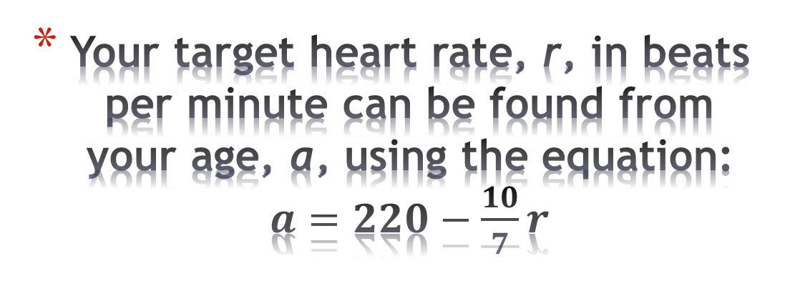
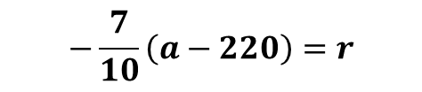

Your target heart rate, r, in beats per minute can be found from your age, a, using the equation: $a=220−\frac{10}{7}r$
Solve the formula for r and write a reason for each step.
Statement | Reason
$$a=220−\frac{10}{7}r$$
Given
Subtraction property of equality (- prop of =)
$$a−220=−\frac{10}{7}r$$
$$−\frac{7}{10}\left(a−220\right)=r$$
Multiplication property of equality (× prop of =)

Slide 9

Check Point. The formula to convert Fahrenheit to Celsius is $C=\frac{5}{9}\left(F−32\right)$.
Solve the formula for F and write the reasons.
Use the result to find the Fahrenheit temperature at 24ºC.

Slide 10
Homework
p. 96 Complete #13-23 mentally, complete #24-27 in writing

